Slide 1
Storytelling & Visualization 2
James R. Bradley

Slide 2
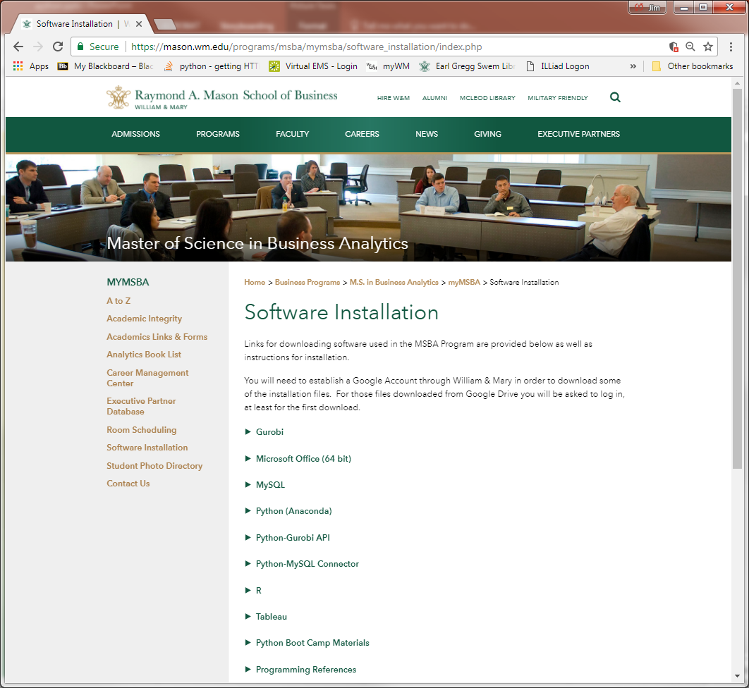
Python (Anaconda) Installation
MSBA software
mason.wm.edu/current/mymsba/software_installation/index.php
Click on the arrow

Slide 3
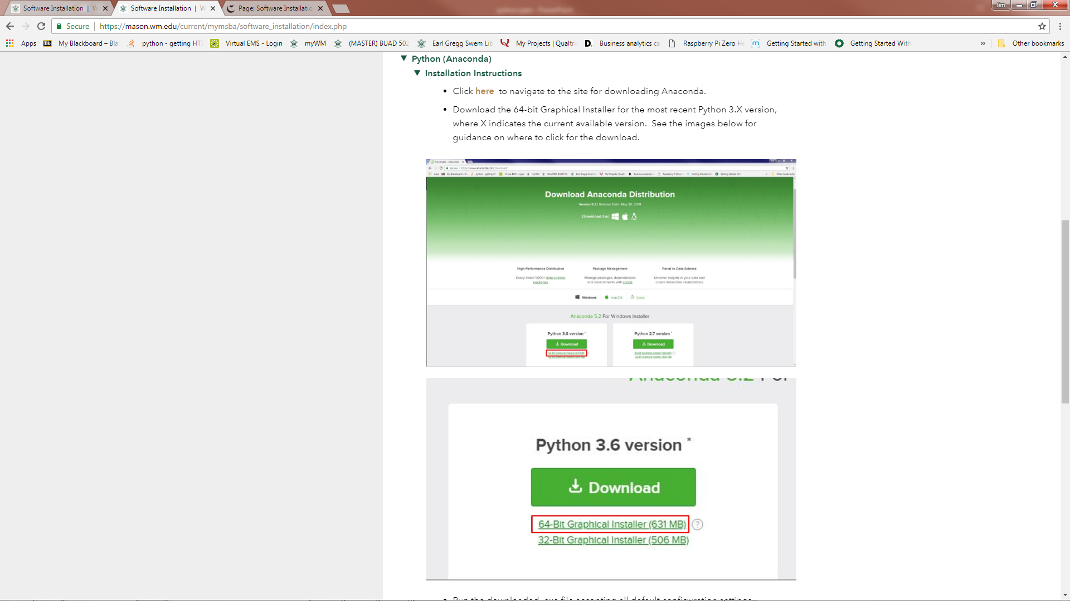
Python (Anaconda) Installation
Follow installation instructions

Slide 4
Files for Today
Jupyter notebook
MatplotlibGraphExamples.ipynb
Python files
matplotlib_eg_line.py
matplotlib_eg_scatter.py
Data
test.csv
ozone.csv
ConstructionTimeSeriesDataV2.csv

Slide 5
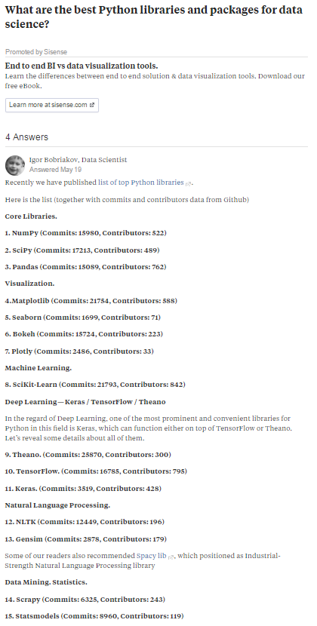
Today’s Topics
Web page for popular Python packages

Slide 6
Today’s Topics
Graphing
How to create graphs with Python
Different graphs for different purposes
Python graphing packages
matplotlib
seaborn
seaborn is built on matplotlib
seaborn has more capabilities
Well focus today on matplotlib because you can’t master seaborn without it
The pandas package is for handling data

Slide 7
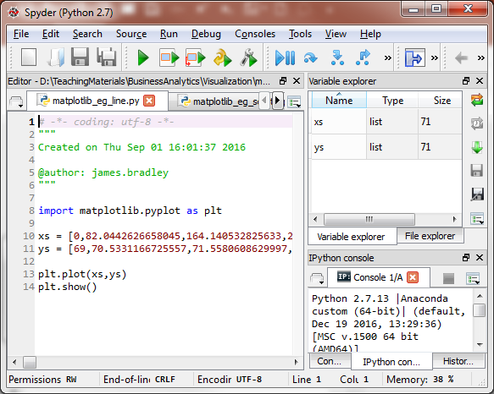
Matplotlib Introduction
matplotlib examples
Open and execute these programs in Spyder
matplotlib_eg_line.py
matplotlib_eg_scatter.py
Import matplotlib
Data (Python list)
Determines type of graph: plt.plot() creates line graph
This statement is required in Spyder for graphs to be rendered

Slide 8
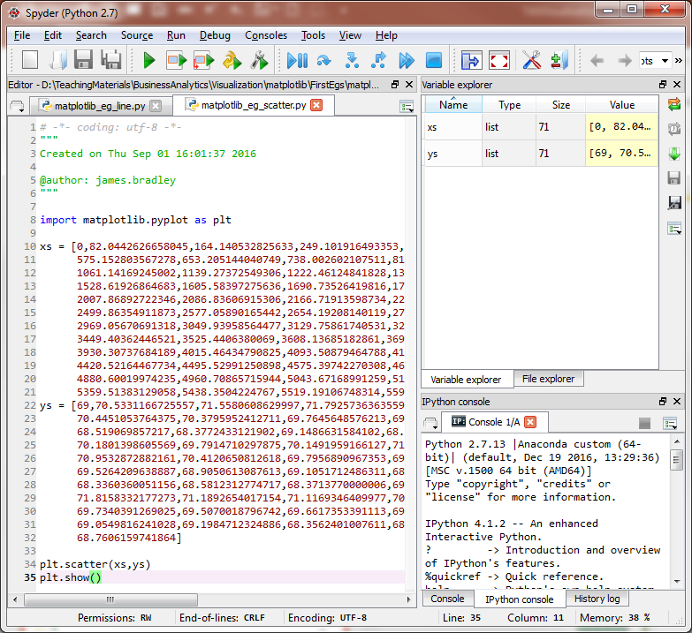
Matplotlib Introduction
Open and execute this program in Spyder
matplotlib_eg_scatter.py
Determines type of graph: plt.scatter creates scatterplot

Slide 9
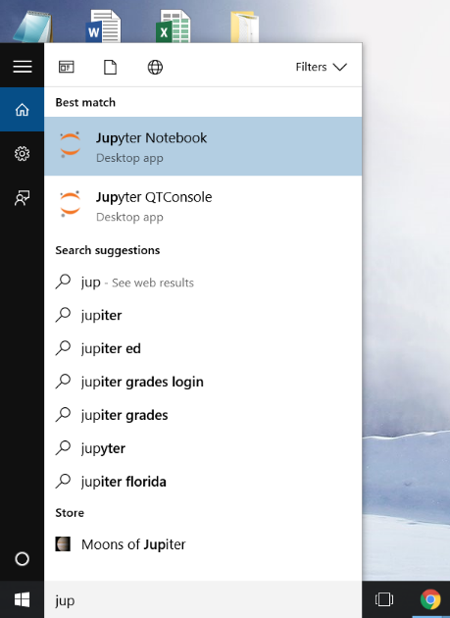
Matplotlib Introduction
Open Jupyter, and create a new notebook
Windows 10

Slide 10
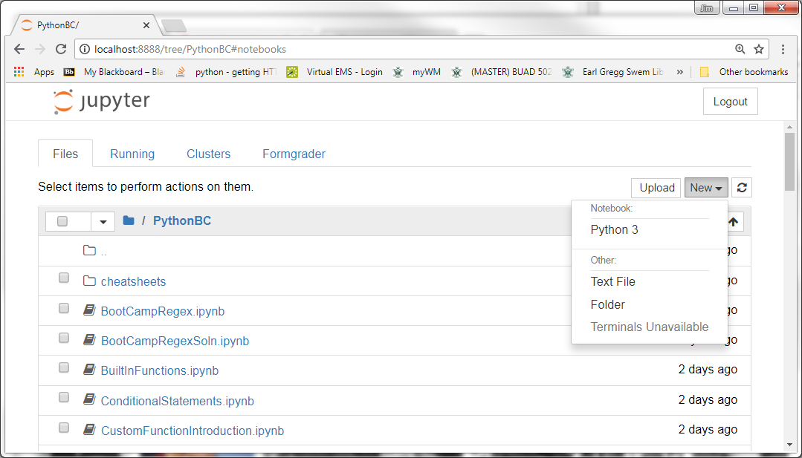
Matplotlib Introduction
Open new notebook
Click on New
Choose Python 3
The 3 refers to Python 3.X versus 2.7
1
2

Slide 11
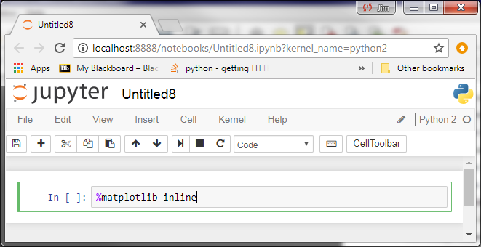
Matplotlib Introduction
Paste this into the first cell
%matplotlib inline
Cause graphs to appear in Jupyter notebook

Slide 12
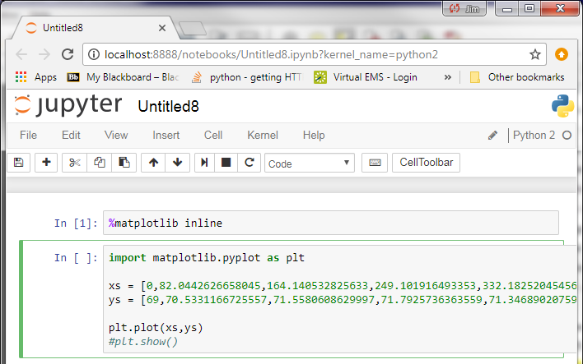
Matplotlib Introduction
Paste this program into the next cell
matplotlib_eg_line.py
Comment out plt.show()

Slide 13
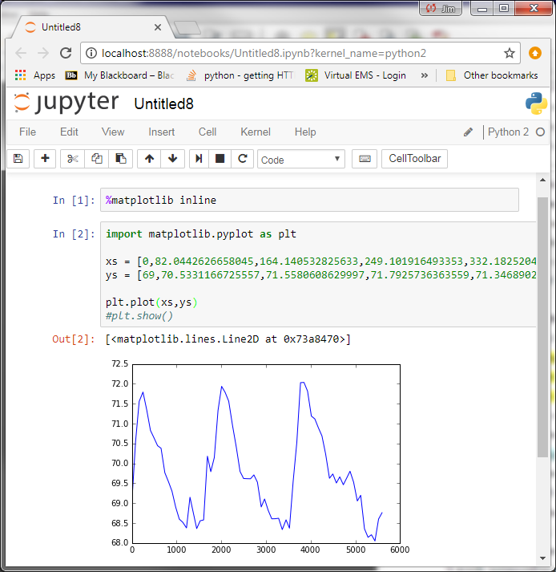
Matplotlib Introduction

Slide 14
Why the Details?
The method in the preceding slides is simple and possibly good for a quick look at data
Okay for exploratory phase
Graphs for presentations require more attention to the details so that they are clear and effective
These are possible with matplotlib as well
matplotlib versus Tableau

Slide 15
Exercise
Simple line graph
Create x series integer data 0 through 99
y series data is a list of 100 floating-point numbers that are random, uniformly distributed from 0 to 1

Slide 16
Graphing Example
Practice graphing details and get a feel for matplotlib graph structure
Open this Jupyter notebook
MatplotlibGraphExamples.ipynb
You’ll need to place this notebook in the Jupyter default directory
Use this notebook as a recipe book
Many more graph attributes to explore

Slide 17
Preliminaries
To import matplotlib package
import matplotlib.pyplot as plt
plt is a standard, ubiquitous alias
Remember %matplotlib inline
Causes graphs to appear in Jupyter notebook

Slide 18
Pandas Package Overview

Slide 19
Preliminaries
pandas is a popular Python package for handling, analyzing data
Import pandas package
import pandas as pd
Convenient function for reading comma separated text files
pd.read_csv(‘file_path’)
First line of file should have column headings
See Jupyter notebook for pandas sample code

Slide 20
Exercise
Pandas exercise
Extract the radiation series; extract the first 50 points from radiation

Slide 21
matplotlib Details: Graph Attributes

Slide 22
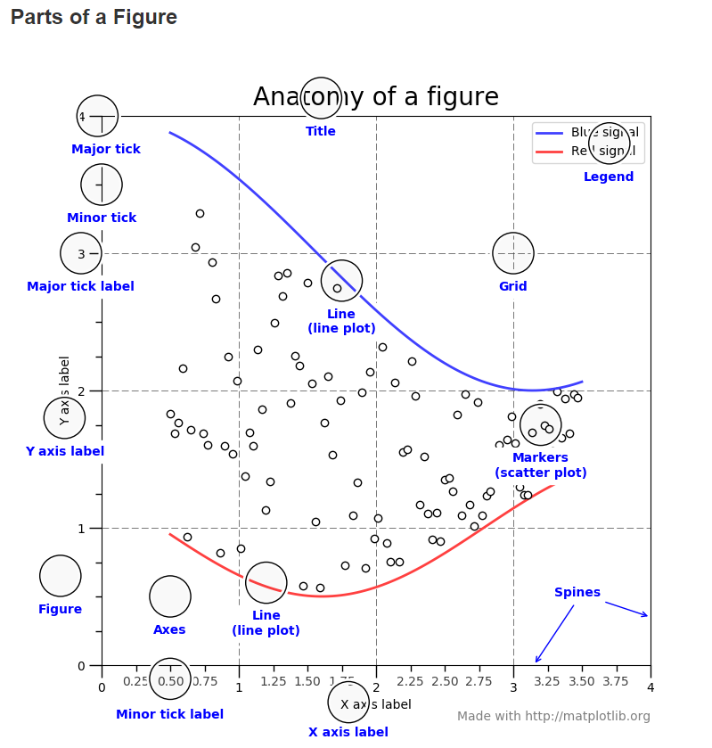
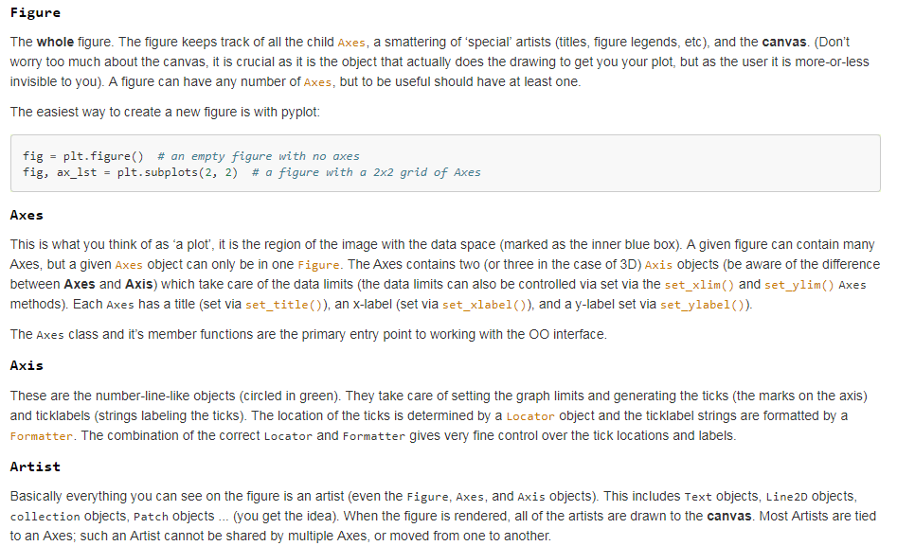
Graph Structure
Terminology
https://matplotlib.org/tutorials/introductory/usage.html

Slide 23
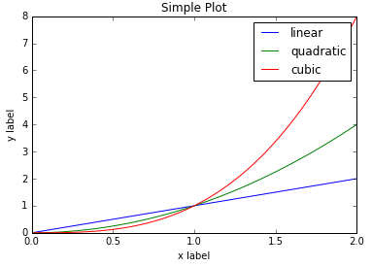
Graph Structure
figure
suptitle
axes
figure
suptitle
axes

Slide 24
Graph Structure
axes
legend
hlines
vlines
yaxis
xaxis
axes
legend
yaxis
xaxis
hlines
vlines

Slide 25
Graph Structure
xaxis
xaxis tickmarks
xaxis label
xaxis tickmark labels
xaxis
xaxis tickmarks
xaxis label
xaxis tickmark labels

Slide 26
Graph Structure
Putting the hierarchical structure together…
figure
suptitle
axes
legend
yaxis
xaxis
hlines
vlines
xaxis tickmarks
xaxis label
xaxis tickmark labels

Slide 27
matplotlib Graph Attributes
See these references for plotting attributes
https://matplotlib.org/api/axes_api.html#matplotlib.axes.Axes
https://matplotlib.org/api/pyplot_summary.html
http://matplotlib.org/Matplotlib.pdf
http://kestrel.nmt.edu/~raymond/software/python_notes/paper004.html
Example attributes
Graph size
Line/point colors
Line width
Font size
Chart title
y-axis scale (linear, logarithmic)
Grid lines
Explore attributes: Type plt., fig., ax., then Tab
In-graph text
Annotation lines
Legend
Legend location
Spines
Tickmarks
Tickmark labels

Slide 28
Relationships
XY Scatter Plots show the relationship between two variables
Data often come from multiple points in time
Not necessarily with constant time intervals like the previous example
Horizontal axis has the units of one variable series
Vertical axis: the units of the other variable series

Slide 29
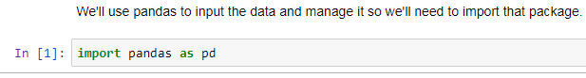
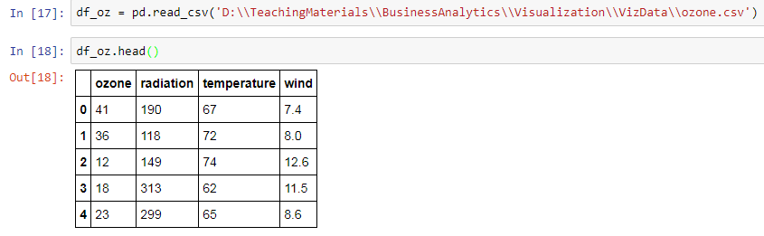
Preliminaries

Slide 30
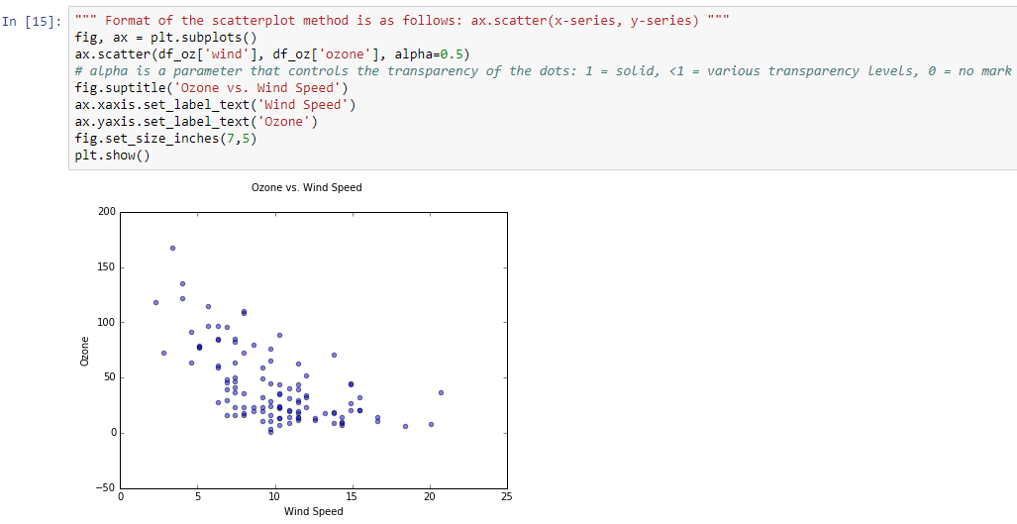
Relationships
See MatplotlibGraphExamples.ipynb
What is Ozone and Wind Speed relationship?
Basic syntax:
ax.scatter(x,y)

Slide 31
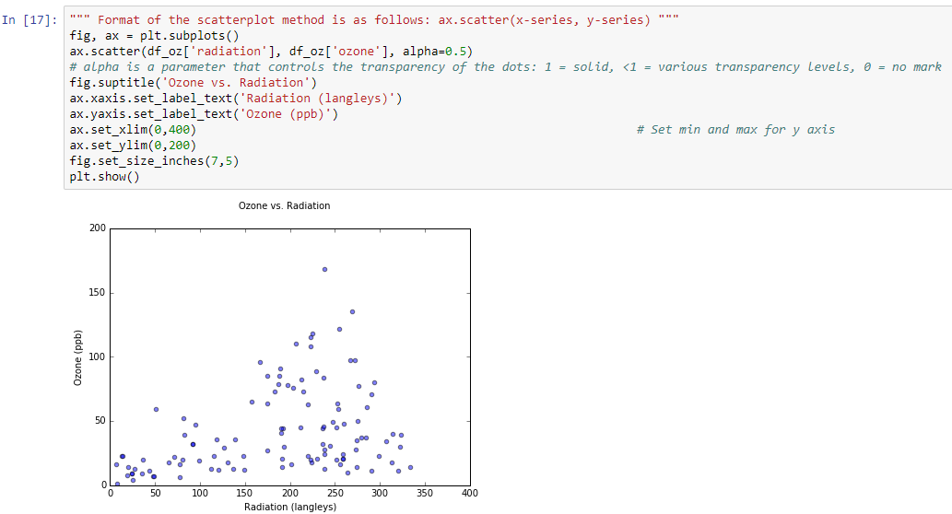
Relationships
What is the relationship between Ozone and Solar Radiation?

Slide 32
Exercise
Scatterplot of ozone versus temperature from df_oz

Slide 33
Exercise
Pandas simple graphing
Graph line graph of temperature from df_oz

Slide 34
Distributional Data
Distributional data are multiple observations
Of a particular variable of interest
Each variable value is accompanied by other categorical and numerical data fields
Standards of Learning test scores
Multiple students yield multiple observations
Scores range from 0 to 100 in the data
Collected at beginning of year (also at year end)
Students of different instructors, different schools
Compare distributions for different ancillary data
File: test.csv, DataFrame: df_test

Slide 35
Distributional Data
Frequency Histograms show how many observations exist for each variable value
Horizontal axis:
The variable values observed, possibly binned
For example, test scores at end of the year
Vertical axis:
Height of column proportional to the number of observations for each measurement/bin

Slide 36
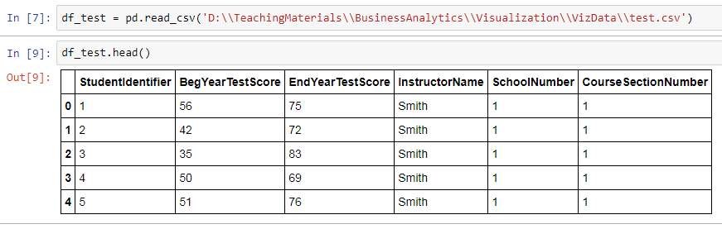
Preliminaries
Input the data with pandas

Slide 37
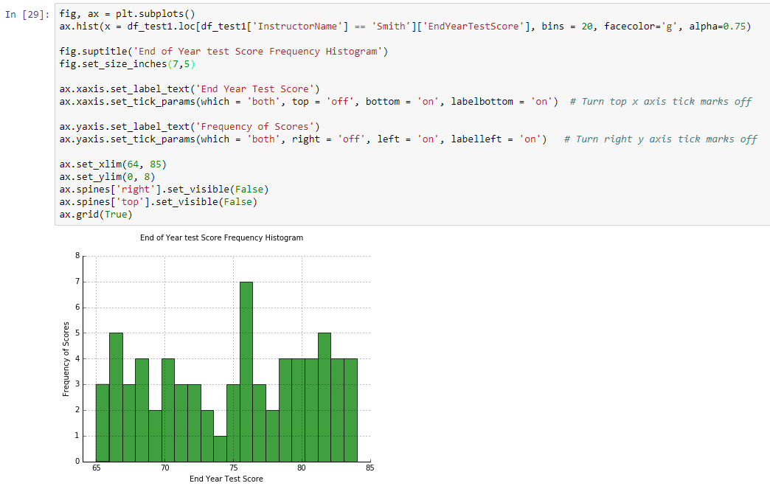
Distributional Data
Frequency Histogram for Instructor Smith
Basic syntax:
ax.hist(x)

Slide 38
Exercise
Histogram of a DataFrame series (column):
Temperature column from df_oz DataFrame

Slide 39
Compare Distributional Data
We often want to compare distributions of one or more variables
Frequency histograms are poor for this task

Slide 40
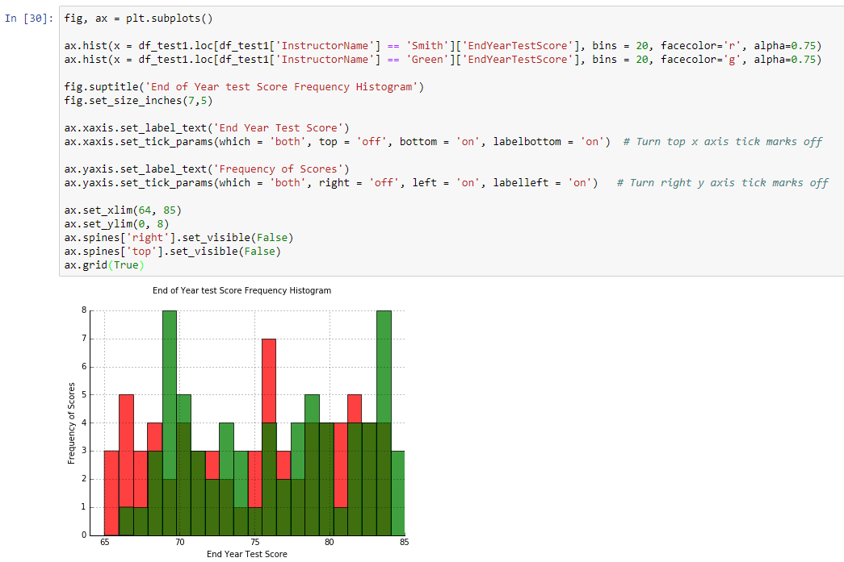
Distributional Data
Superimposed frequency histogram
Is this clear, effective?

Slide 41
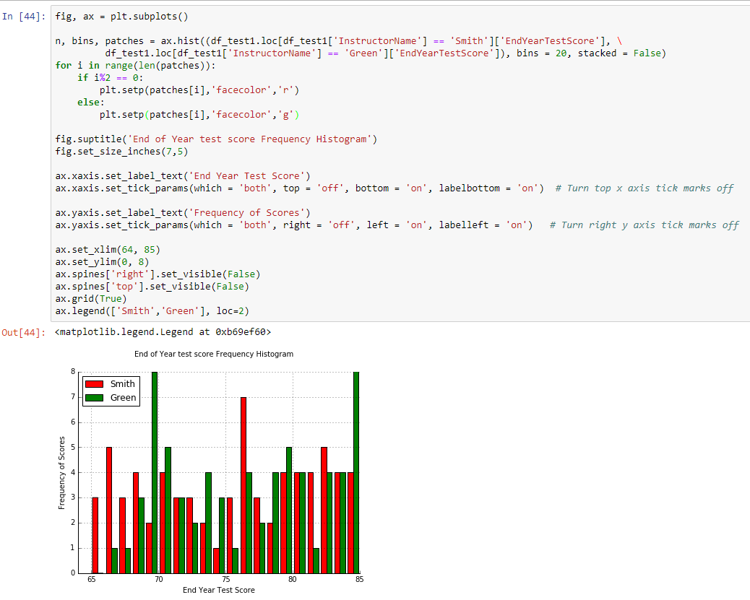
Distributional Data
Side-by-side frequency histogram
Is this clear, effective?

Slide 42
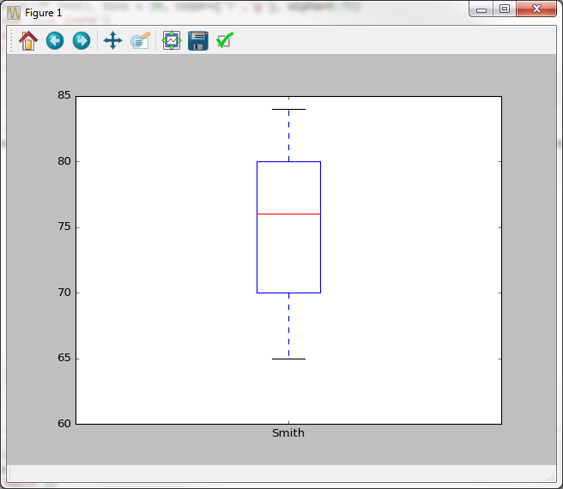
Distributional Data
Box Plots compare distributional data
Short-hand for the distribution
Frequency histogram rotated 90 degrees
Maximum Score
3rd Quartile Score 75% of scores at or below this point
Median score 50% of scores at or below this point
1st Quartile Score 25% of scores at or below this point
Minimum Score

Slide 43
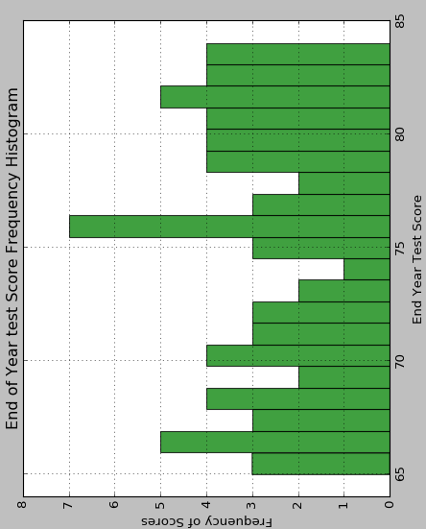
Distributional Data

Slide 44
Distributional Data
Box Plots
Horizontal axis tick marks:
One tick mark for each data series distribution
Vertical axis:
Scale is measurement values
Boxplot denotes min, 1st quartile, median, 3rd quartile, max, & possibly outliers.

Slide 45
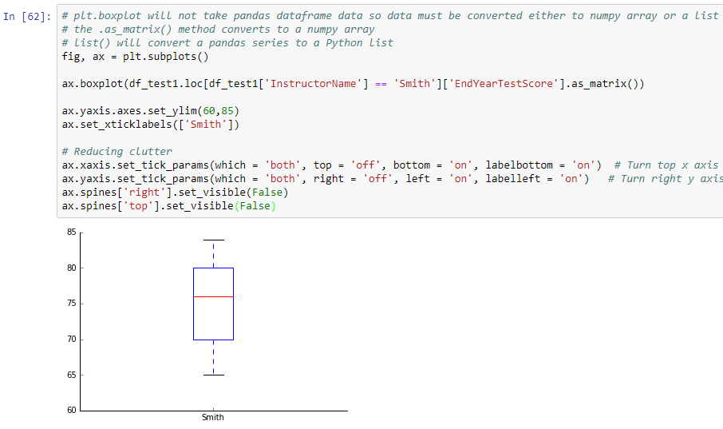
Distributional Data
Data must be in numpy array or Python list

Slide 46
Exercise
Box plot of a DataFrame series:
Radiation column from df_oz

Slide 47
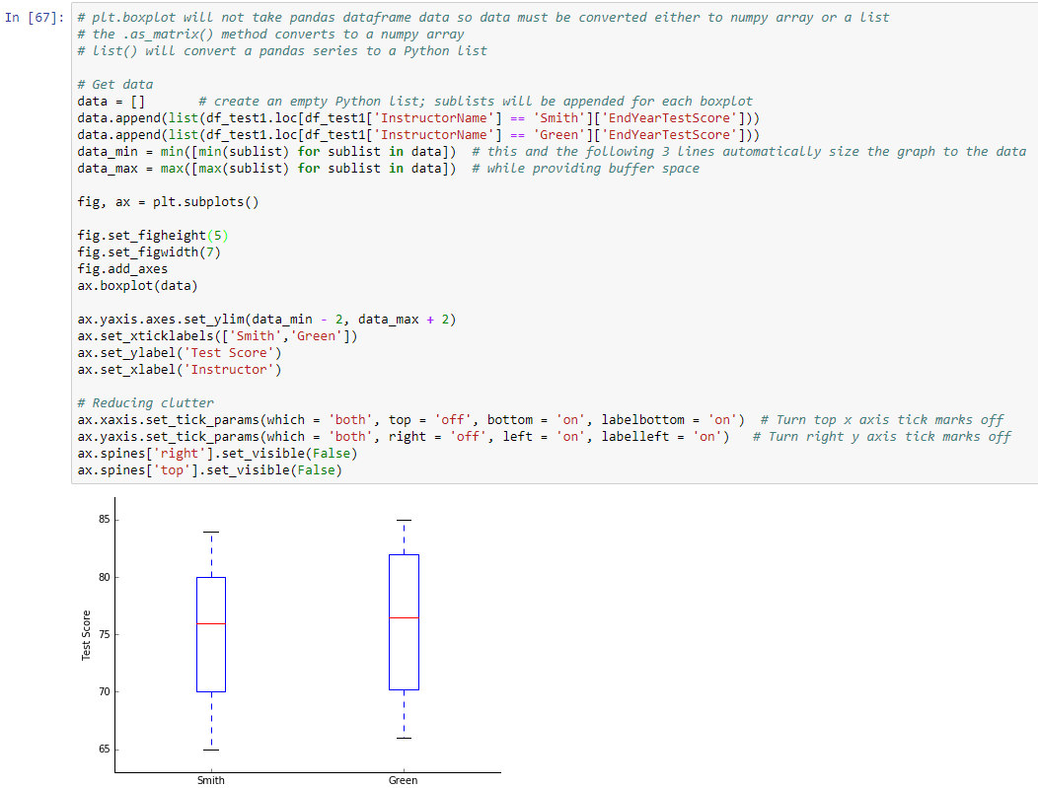
Distributional Data
Are the distributions similar, or not?

Slide 48
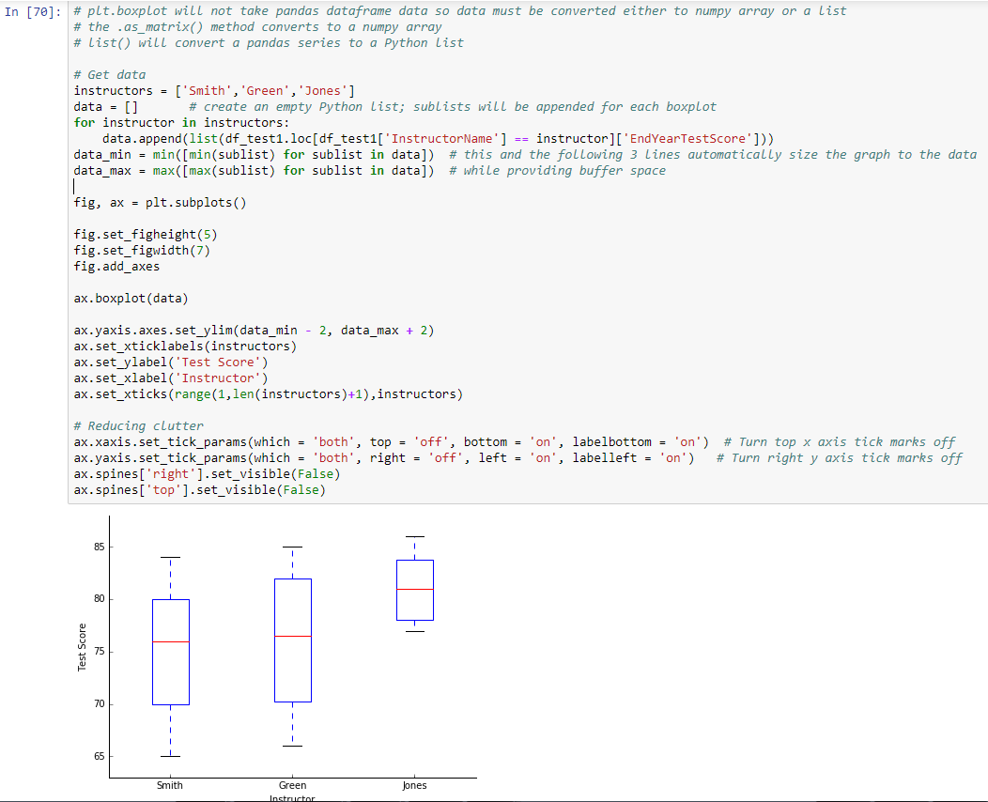
Distributional Data
Similar distributions or different?

Slide 49
Exercise
Multiple box plots on same axes
Create a boxplot using the test data that compares beginning of year test scores for School 1 versus School 2.

Slide 50
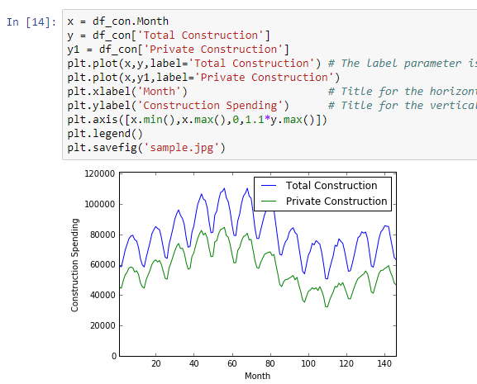
First Look at the Data
Simple approach… with a little embellishment

Slide 51
Storytelling Assignment
This is the first installment of material for the Storytelling & Visualization Assignment
This is the data file you’ll use
We’ve used pandas to handle the data
You can use other methods as well
The assignment also requires that you create a presentation
The next lecture addresses that topic

Slide 52
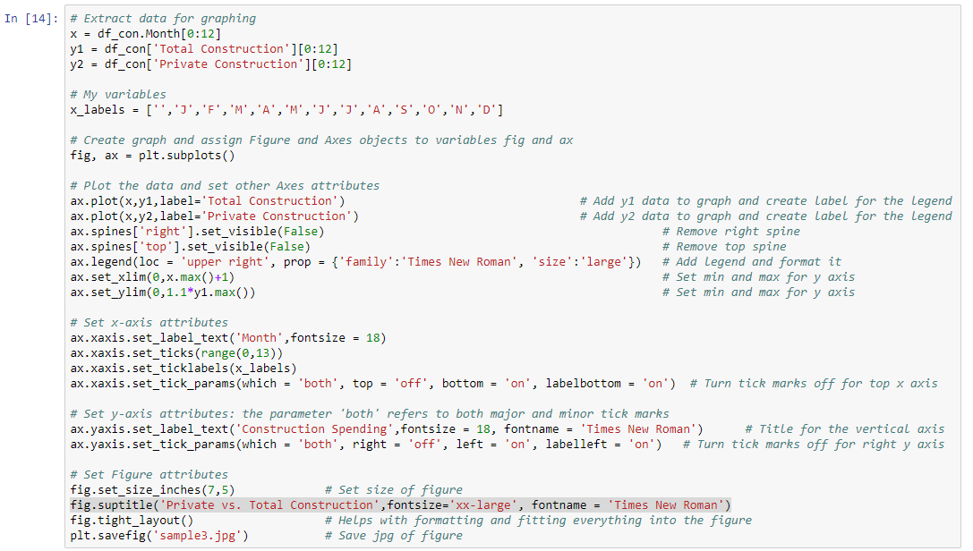
Single Plot
Look at first year of data

Slide 53
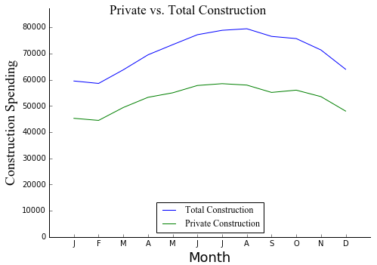
Single Plot

Slide 54
Saving matplotlib Graphs
Save images as .png or .jpg files
E.g., plt.savefig('sales.png')
Screenshot approach
Click on window containing the graph, Alt+PrintScreen copies graph to clipboard
Snipping Tool

Slide 55
Exercise
Multiple line plots on same axes
Create x series integer data 0 through 99
Two y series, y1 and y2, each with a list of 100 floating-point numbers that are random, uniformly distributed from 0 to 1

Slide 56
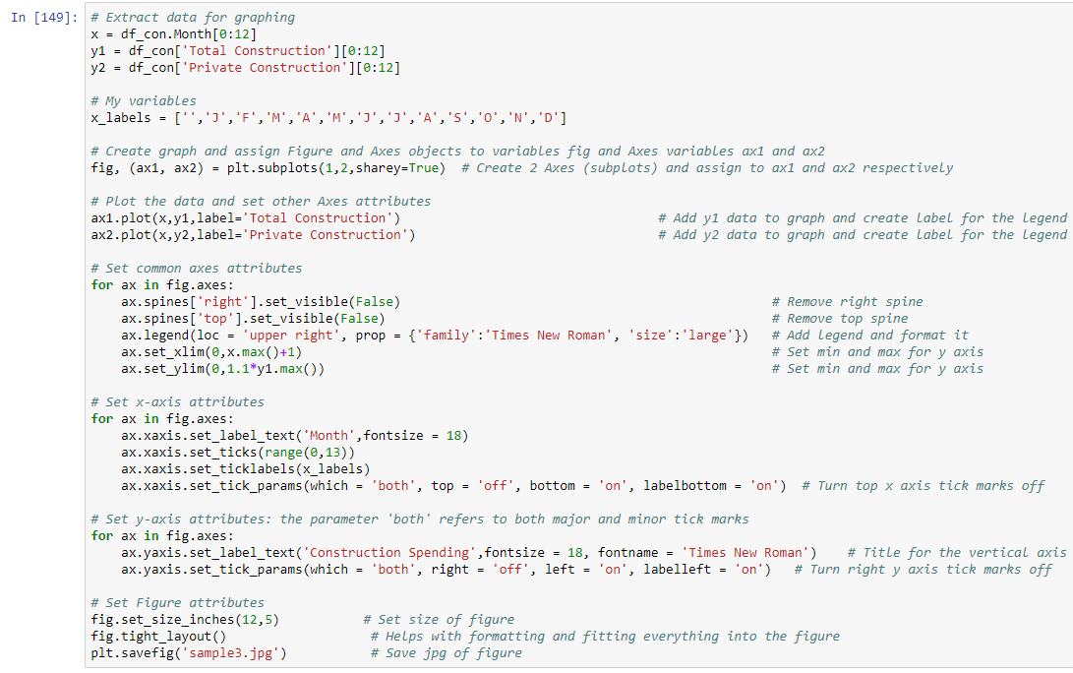
Double Plot

Slide 57
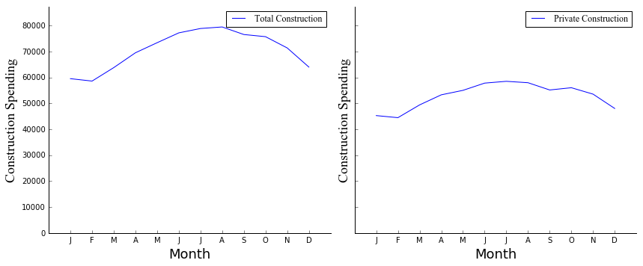
Double Plot

Slide 58
Time Series Data
A time series plot is most appropriate when comparing a value that changes over time
Time on horizontal axis
Points connected with lines
Symbols at datum points

Slide 59
Discussion Points
Multiple ways to set some graph attributes
… I am showing one, most understandable, way
Hopefully, this instruction is logical and understandable
If so, making knowledge easily accessible is good, on one hand
On the other hand, you need to know that learning on your own is not always easy
Don’t be surprised why learning new methods is time consuming and frustrating

Slide 60
Highlight What’s Important
Focus on the most important items on a list:
Defects causing most of quality problems
Issues causing most help desk calls
Software bugs causing the greatest number of help desk requests
Products that contribute most toward revenue
Items constituting most value in inventory
Web pages/sites that have the most traffic
Root causes causing most production downtime
These data often resemble the “80-20 Rule”
80% of the problem caused by 20% of the items
Not always exactly 80% and 20%

Slide 61
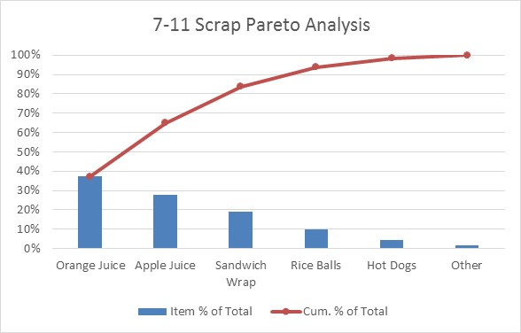
Highlight What’s Important
Pareto charts have a standard format
Plot it this way, exactly, or people will think you don’t know what you’re doing

Slide 62
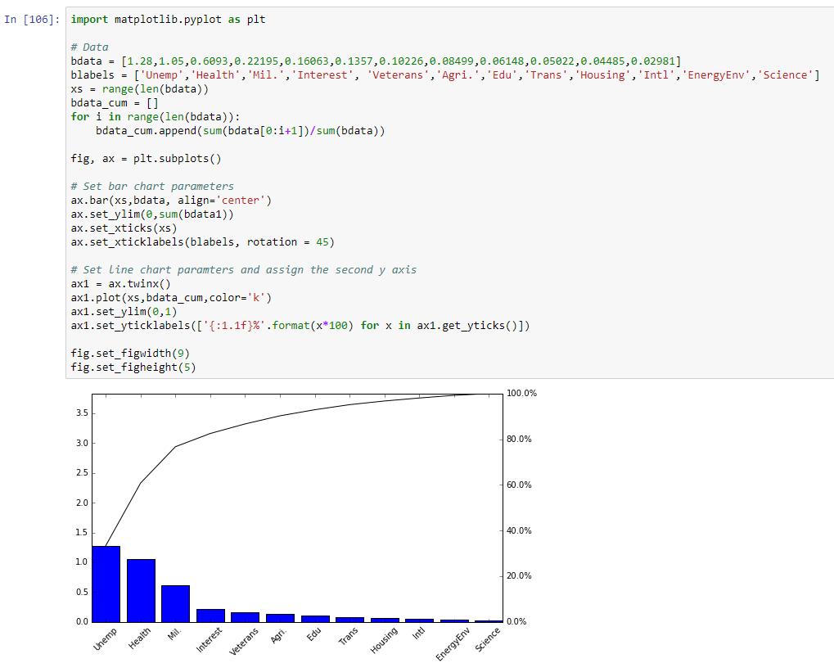
Highlight What’s Important
US budget data

Slide 63
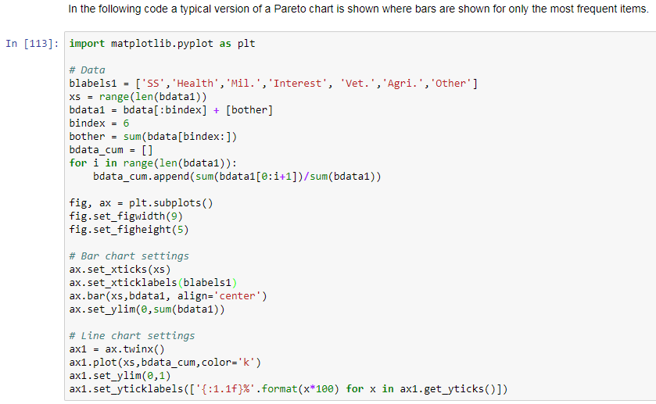
Highlight What’s Important
Introduce ‘Other’ category for long tail of small measurements

Slide 64
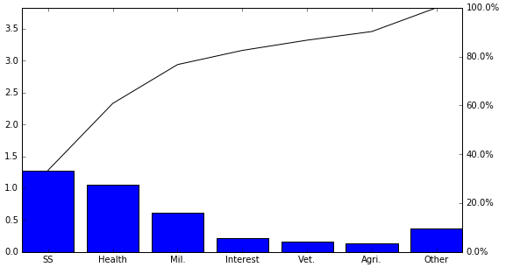
Highlight What’s Important
Introduce ‘Other’ category for long tail of small measurements

Slide 65
Quick Introduction to seaborn

Slide 66
Python seaborn Package
seaborn is based on, and embellishes matplotlib
Some examples are shown in the following slides
In SeabornGraphExamples.ipynb

Slide 67
Install seaborn
Not included in base Anaconda installation
Install seaborn in Anaconda:
Open Anaconda Command Prompt, by right-clicking and choosing the Run as administrator option
Type conda install seaborn, then Enter
In Python code:
import seaborn as sns
sns is a standard, ubiquitous alias
Reference
https://stanford.edu/~mwaskom/software/seaborn/examples/

Slide 68
seaborn pairplot
The df_oz DataFrame includes 4 data series
seaborn pairplot permits pairwise comparisons of all data fields

Slide 69
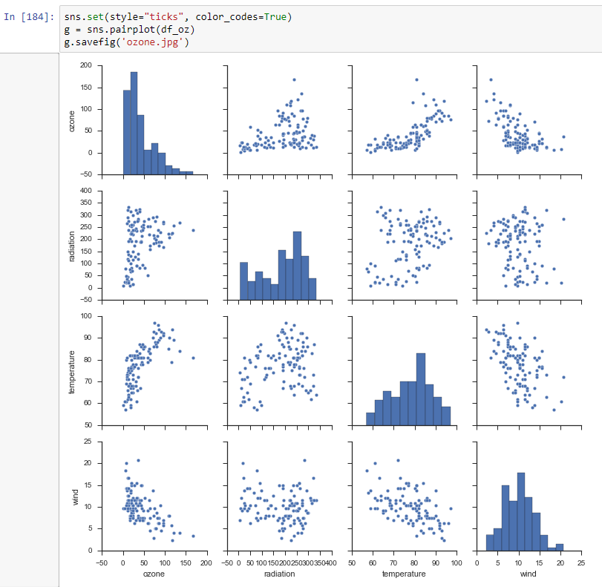
seaborn pairplot
seaborn pairplot compares 4 data series

Slide 70
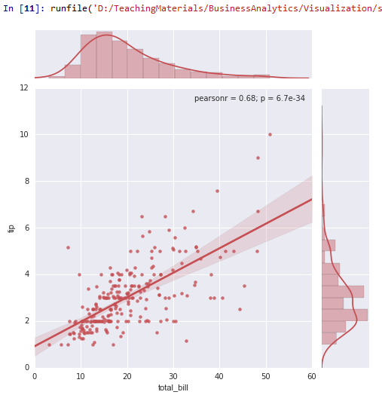
seaborn jointplot
x and y marginal distributions

Slide 71
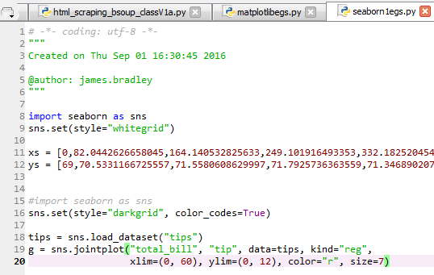
seaborn jointplot
x and y marginal distributions

Slide 72
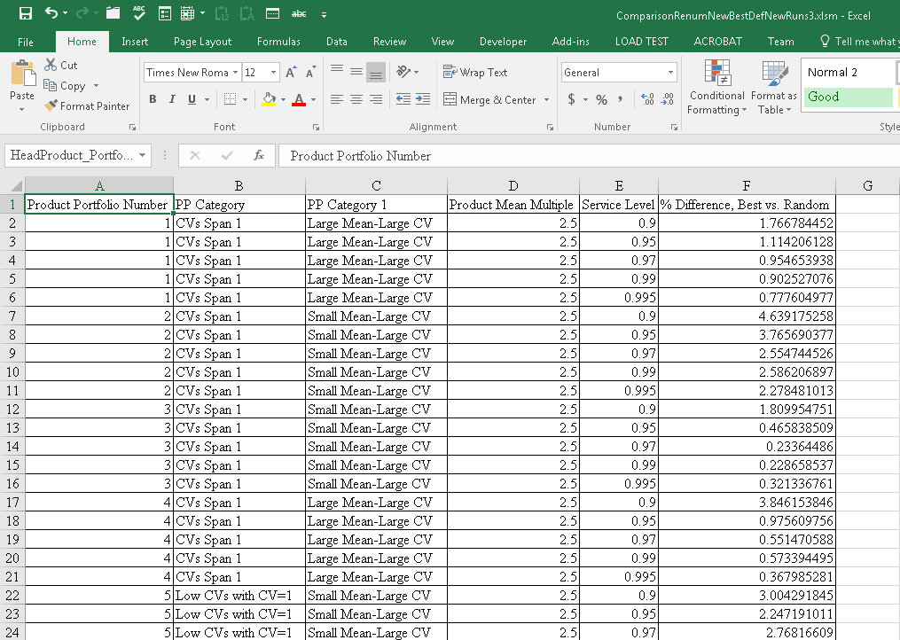
seaborn facetgrid
40 series to be shown in line charts

Slide 73
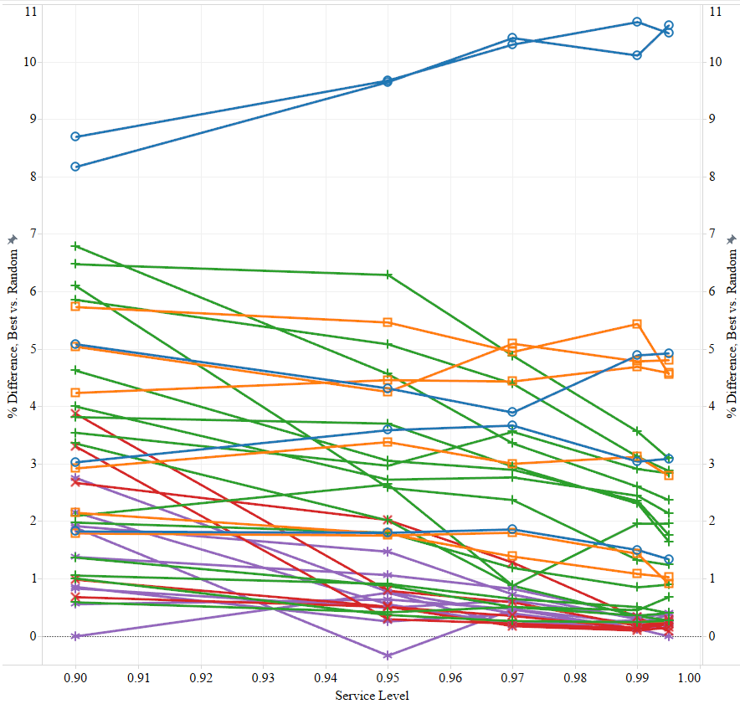
seaborn facetgrid
Here’s a Tableau graph

Slide 74
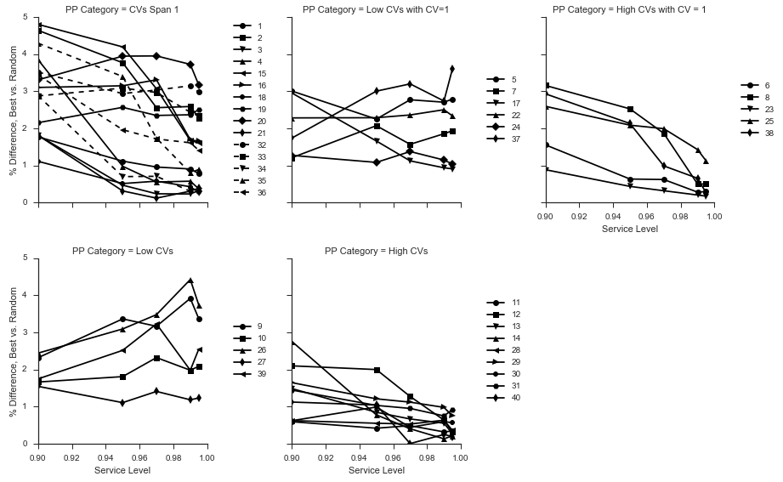
seaborn facetgrid
Sort lines into 5 windows with unique formats

Slide 75
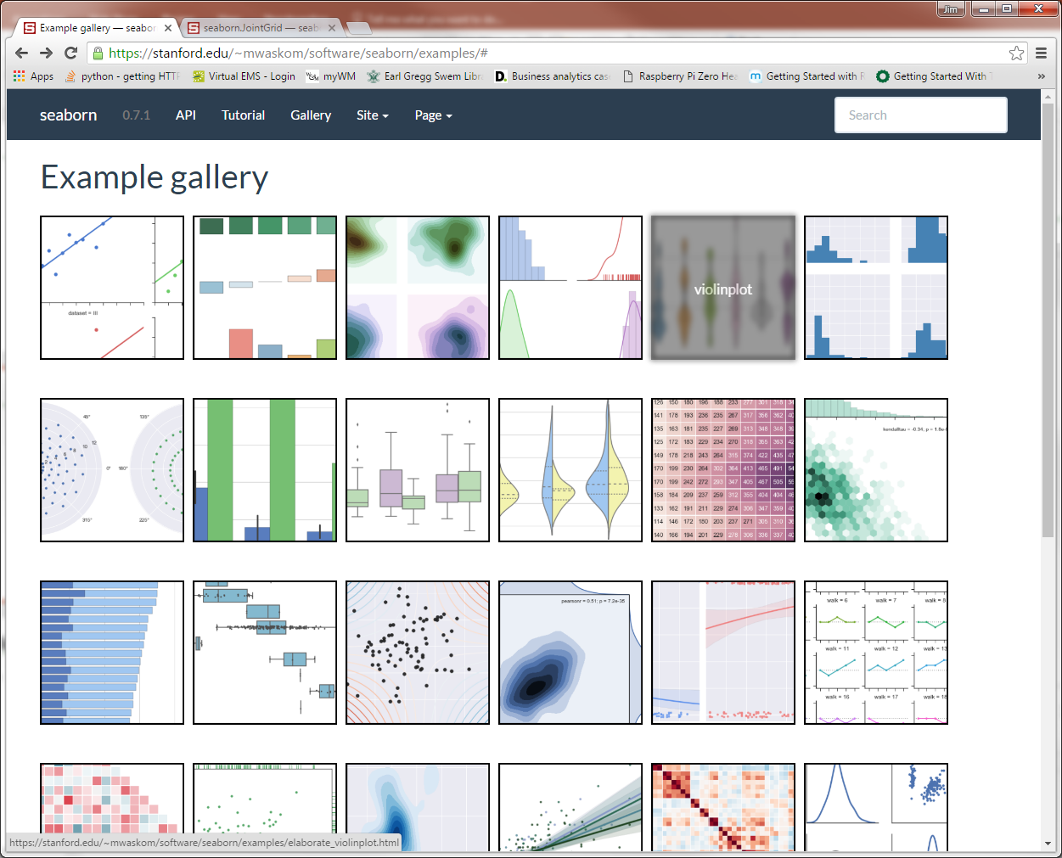
Other seaborn Examples
http://seaborn.pydata.org/examples/

Slide 76
Summary

Slide 77
Different Purpose, Different Method
Depending on where in CRISP-DM the appropriate software and effort vary
Understanding the data
Rough, fast graphics
Python, Excel
Final presentation, deployment
Refined, sleek matplotlib or seaborn
Need to get into the details
Tableau

Slide 78


Different Purpose, Different Method
Different data, different plot type
Different process step, different modality
Pose Business Question
OR
Pose Business Question
Quick and Rough Visualizations Here
Data Acquisition & Cleansing
Refined Visualizations Here

Slide 79
Making Sense of Big Data
Emerging: listening to data
https://www.nasa.gov/content/goddard/more-than-meets-the-eye-nasa-scientists-listen-to-data/#.V5tjdeuANBc

Slide 80
Additional Material

Slide 81
Changing Jupyter Default Folder
Right Click on Jupyter in Start menu
Choose Properties
Change Start In path to desired path
Delete %USERPROFILE%
Check C:\Users\username\.jupyter\ folder for this file: jupyter_notebook_config.py
If missing, then create it:
Open Command Prompt from Start menu
Execute this command
jupyter notebook --generate-config
In jupyter_notebook_config.py, uncomment this line and enter path string
#c.NotebookApp.notebook_dir = ''

Slide 82
Shutting Down Jupyter

Slide 83
Jupyter Notebook Set-up
Ending Jupyter
Save your work
Go to the home browser screen
Click on Running tab
Click on Shutdown button for the notebooks you want to close
Find the Jupyter Notebook Command Window and type Ctrl+c

Slide 84
Jupyter Notebook Set-up
Ending Jupyter
Save the notebook
Go to the home browser screen
Click on Running tab
Click on Shutdown button for the notebooks you want to close
Find the Jupyter Notebook Command Window and type Ctrl+c

Slide 85
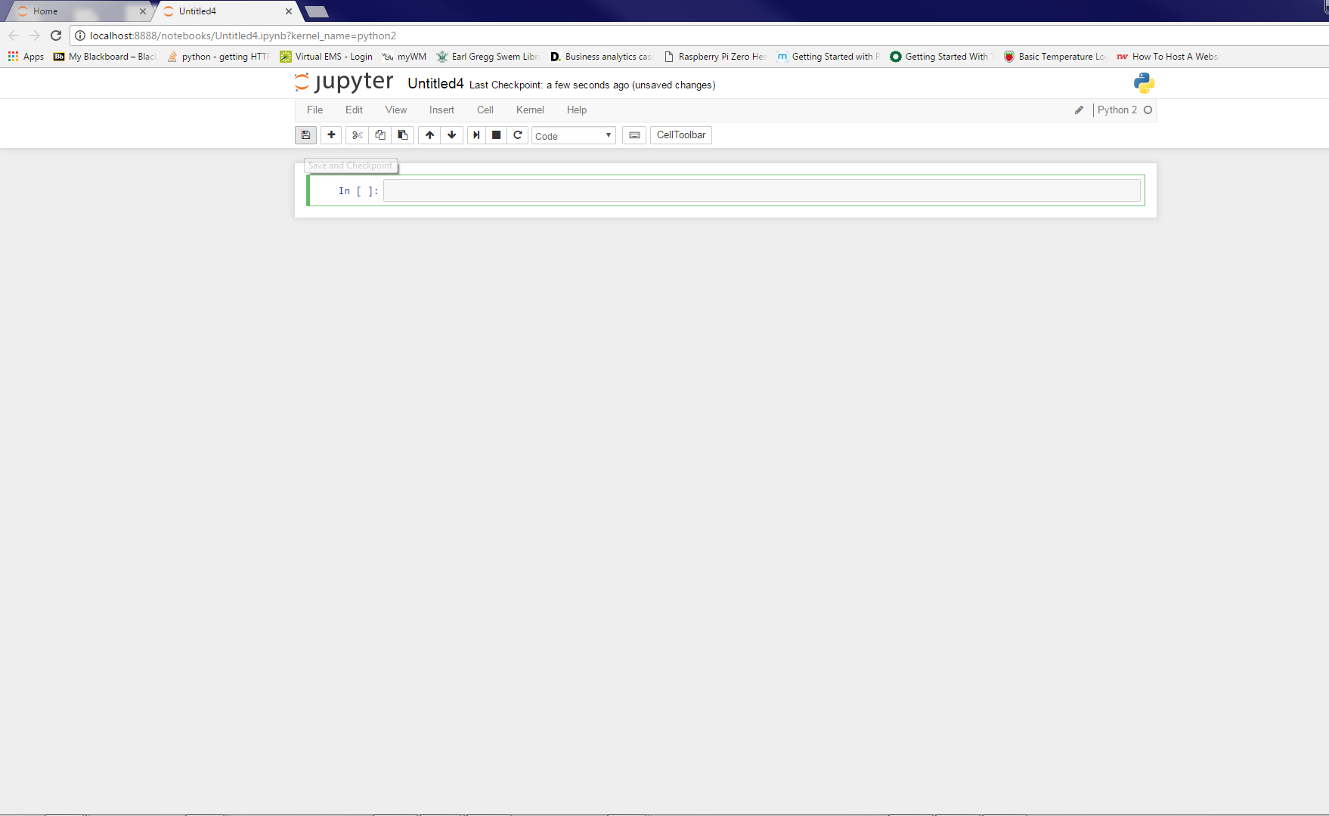
Jupyter Notebook Set-up
Save the notebook

Slide 86
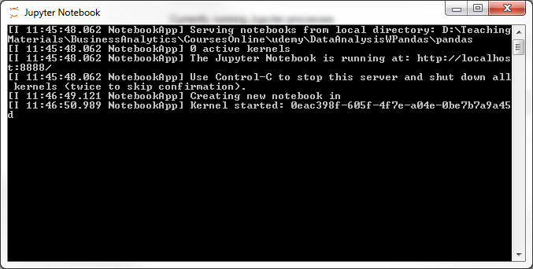
Jupyter Notebook Set-up
Type Ctrl-c to stop Jupyter server

Slide 87
GIS Graphs Back-up

Slide 88
GIS Plots
Use Geographical Information Systems (GIS) plots when geographical information is important (latitude, longitude)
We won’t cover this today
Can do this with Python
Other software, perhaps, is better suited
Tableau

Slide 89
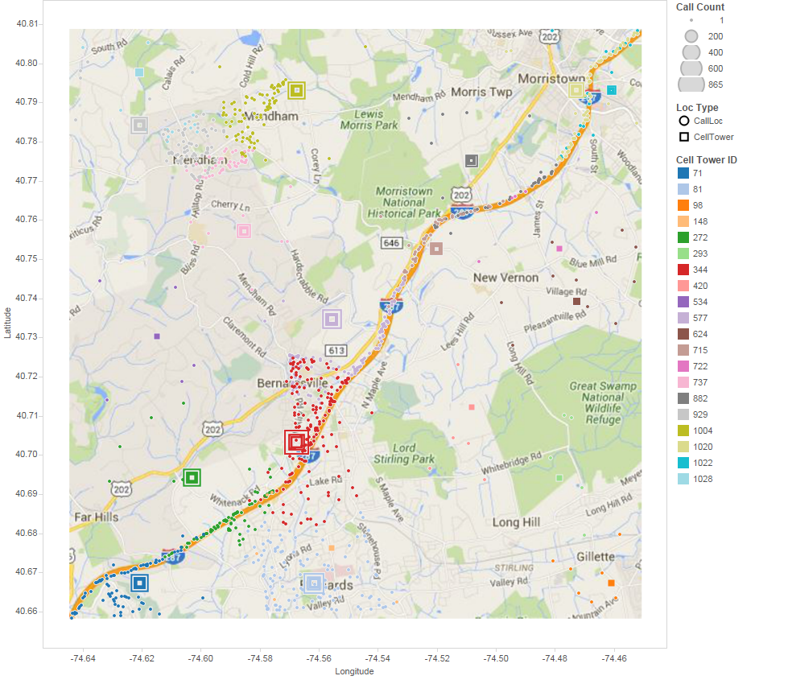
Geographical Data
Tableau is good at GIS plotting

Slide 90
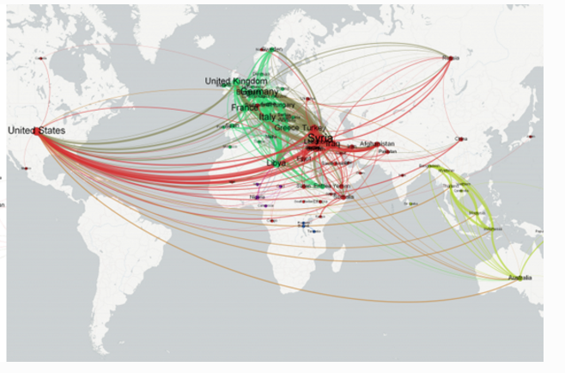
Geographical Data
Global refugee flows
http://blog.gdeltproject.org/network-visualization-of-global-refugee-flows/

Slide 91
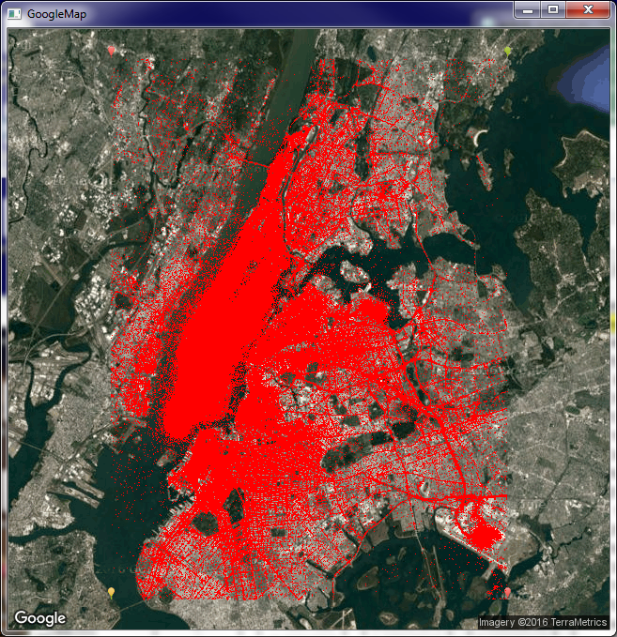
Geographical Data
Google Maps API w/OpenCV

Slide 92
Google Maps API w/OpenCV
OpenCVUberWMarkersWClassBU.py
Takes a while to run
Need to install some packages:
openCV (great for graphical tasks)
Installation directions link
numpy, pandas, tkinter, matplotlib
urllib2
Alternative package to requests
Get data here (posted many places):
http://www.nyc.gov/html/tlc/html/about/trip_record_data.shtml

